Slide 1


Front end
(Introduction to css)
Lecture-19

Slide 2

Today’s Agenda
The CSS Box Model
Border, Padding And Margin
Handing Overflow
Setting Element Pos Using Float

Slide 3
The CSS Box Model
Every element that can be displayed on a web page is comprised of one or more rectangular boxes.
CSS box model typically describes how these rectangular boxes are laid out on a web page.

Slide 4
The CSS Box Model
These boxes can have different properties and can interact with each other in different ways, but every box has 4 very important elements :
a content area
This can be text, images or anything else.
padding
The space between the contents and the border
border
The frame in the defined thickness.
margin
The space between the frame and the next item.

Slide 5
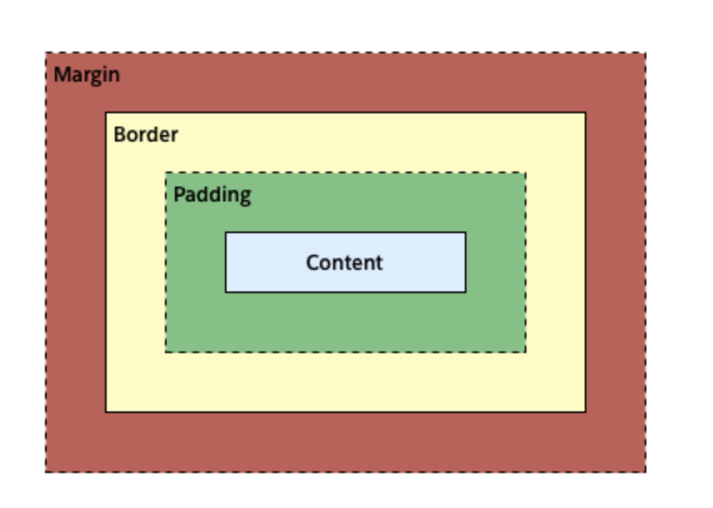
The CSS Box Model

Slide 6
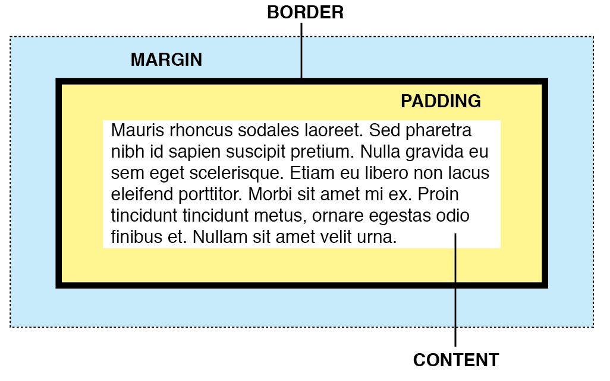
The CSS Box Model

Slide 7
Setting Width And Height
Usually when we set the width and height of an element using the CSS width and height properties, in reality we are only setting the width and height of the content area of that element.
This width and height does not include paddings, borders, or margins.

Slide 8
Example
div
{
width: 300px;
height: 200px;
background: #eee8aa;
}
This will style the div with a width of 300px and a height of 200px.

Slide 9
Padding
The CSS padding properties allow us to set the spacing between the content of an element and its border .
It can be specified using following properties:
padding-top
padding-right
padding-bottom
padding-left
padding

Slide 10
Padding
The padding properties can be specified using the following values:
length - specifies a padding in px, em, rem, pt, cm, etc.
% - specifies a padding in percentage (%) of the width of the containing element.
inherit - specifies that the padding should be inherited from the parent element.

Slide 11
Example
h1
{
padding-top: 50px;
padding-bottom: 100px;
}
This will style the h1 with a top padding of 50px and bottom padding of 100px

Slide 12
Border
The CSS border properties allow us to define the border area of an element's box.
Borders appear directly between the margin and padding of an element.
The border can be a style like, solid line, dotted line, double line, etc.

Slide 13
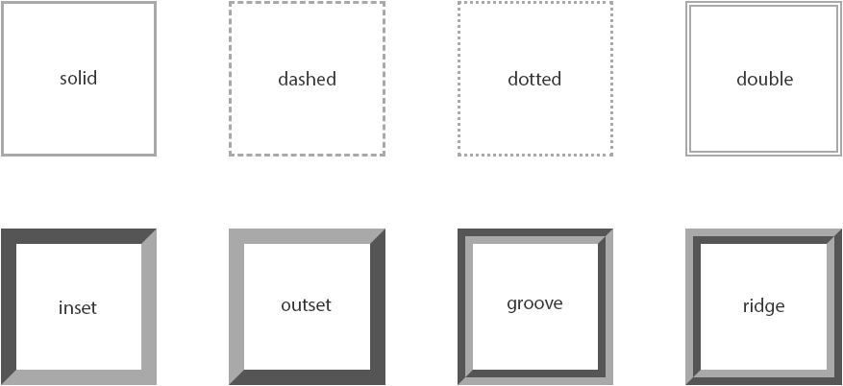
Border

Slide 14
Border
Following are the CSS border properties that can be applied on an element:
border-style
border-width
border-color
border

Slide 15
Example
p
{
border: 5px solid #00ff00;
}
This will style the p with a solid border of 5px and green color

Slide 16
Creating Rounded Borders
CSS3 introduced a new property called border-radius ,which can be used to create rounded corners.
This property typically defines the shape of the corner of the outer border edge.

Slide 17
Example
.box
{
width: 300px;
height: 150px;
background: #ffb6c1;
border: 2px solid #f08080;
border-radius: 20px;
}
This will style the element with a 20px rounded border

Slide 18
Margin
The CSS margin properties allow us to set the spacing around the border
It can be specified using following properties:
margin-top
margin-right
margin-bottom
margin-left
margin

Slide 19
Margin
The margin properties can be specified using the following values:
length - specifies a padding in px, em, rem, pt, cm, etc.
% - specifies a padding in percentage (%) of the width of the containing element.
auto - the browser calculates a suitable margin to use.
inherit - specifies that the padding should be inherited from the parent element.

Slide 20
Example
h1
{
margin: 50px; /* apply to all four sides */
}
This will style the h1 with a margin of 50px on all 4 sides

Slide 21
Using auto For Horizontal Centering
The auto value for the margin property tells the web browser to automatically calculate the margin.
This is commonly used to center an element horizontally within a larger container.

Slide 22
Example
div
{
width: 300px;
background: gray;
margin: 0 auto;
}
The above style rules lets the <div> element take up 300 pixels of horizontal space, and the remaining space will be equally divided between left and right margins.

Slide 23
Handling Overflow
There may be a situation when the content of an element might be larger than the dimensions of the box itself.
In such cases CSS provides a property called overflow which helps us to specify whether to clip content, render scroll bars or display overflow content of a block-level element.

Slide 24
Handling Overflow
Value | Meaning
visible | The default value. Content is not clipped; it will be rendered outside the element's box, and may thus overlap other content.
hidden | Content that overflows the element's box is clipped and the rest of the content will be invisible.
scroll | The overflowing content is clipped, just like hidden, but provides a scrolling mechanism to access the overflowed content.
auto | If content overflows the element's box it will automatically provides the scrollbars to see the rest of the content, otherwise scrollbar will not appear.

Slide 25
Example
div
{
width: 250px;
height: 150px;
overflow: scroll;
}
The above style rules lets the <div> element to generate a scrollbar which becomes active as soon as the content in the <div> overflows.

Slide 26
The float Property
Float is a CSS positioning property.
To understand its purpose and origin, we can recall print design.
In a print layout, the images may be set into the page such that text wraps around them as needed.

Slide 27
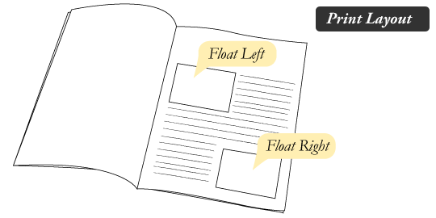
The float Property

Slide 28
How Images And Text Appear In Books ?

Slide 29
The float Property
Similarly in CSS the float property is used to place an element to left or right side of its container, allowing text and other elements to wrap around it
It is generally used to place an image or an element inside its container and other elements will wrap around it.

Slide 30
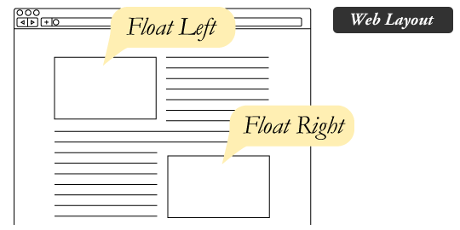
The float Property

Slide 31
Making Divs Appear Side By Side
Normally div elements will be displayed on top of each other.
However, if we use float: left we can let elements float next to each other.
Example:
div { float: left; padding: 15px; }

Slide 32
The clear Property
Elements that come after the floating element will flow around it.
The clear property helps us change this behaviour and move the element below the floating elements that precede it.
The possible values are none, left, right and both.

Slide 33

End Of Lecture
For any queries mail us @: scalive4u@gmail.com
Call us @ : 0755-4271659, 9826686245
Agenda for Next Lecture:
Display & Visibility

